Slide 1
Spring MVC – JSP JSTL
Lesson 26
Notes:
https://docs.spring.io/spring-framework/docs/current/reference/html/web.html#mvc

Slide 2
Agenda
How does internet work
Web App and Web Server
Spring MVC – XML configuration – Home page
Spring MVC – Form processing
Student Page – Request Mapping, Request Param
Spring form tags and data binding with model – Model Attribute
Attempt input text, checkbox, radio button, select option
Loading static resource (images, css, js)
Spring MVC - Form validation
Custom Annotation
Build a CRUD web app with Spring MVC, Hibernate and JSTL
Spring MVC – Java Annotation configuration
Notes:
https://www.youtube.com/watch?v=x3c1ih2NJEg

Slide 3
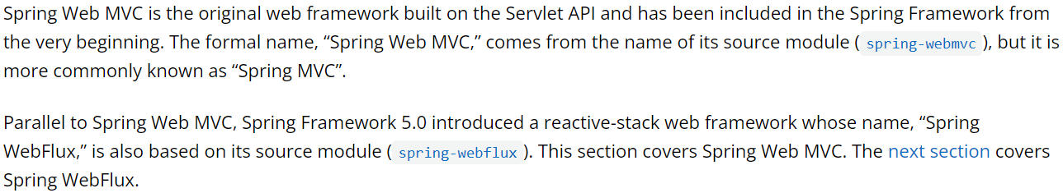
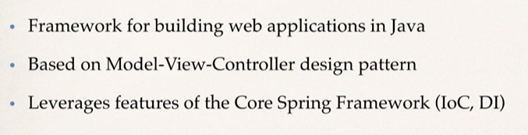
Spring Web MVC

Slide 4
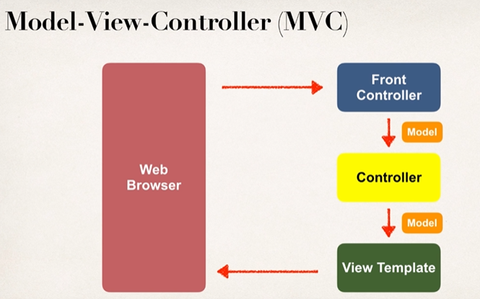
Spring Web MVC
http://something.com/index
Mapping path request
Controller - method
Service

Slide 5
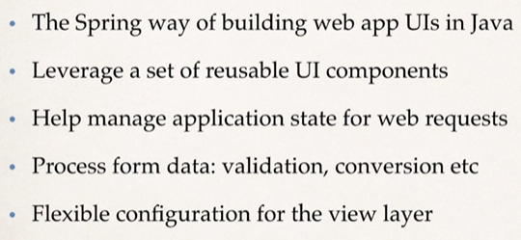
Spring Web MVC - Benefits

Slide 6
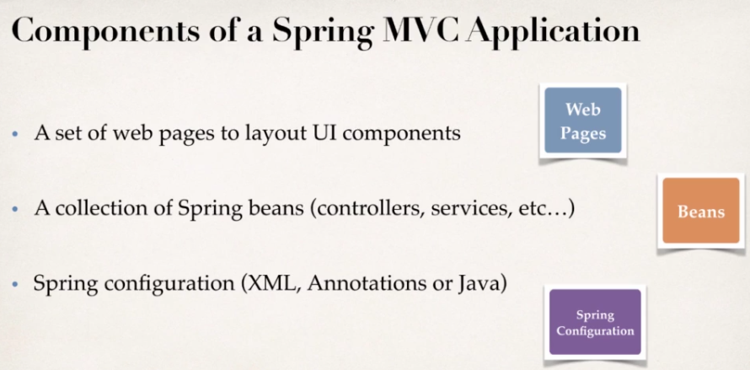
Spring Web MVC – Behind the scene

Slide 7
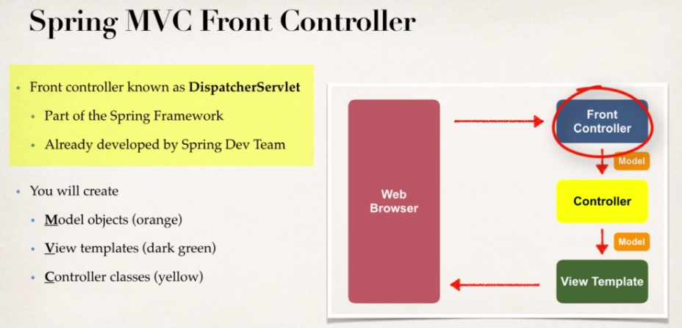
Spring Web MVC – Behind the scene

Slide 8
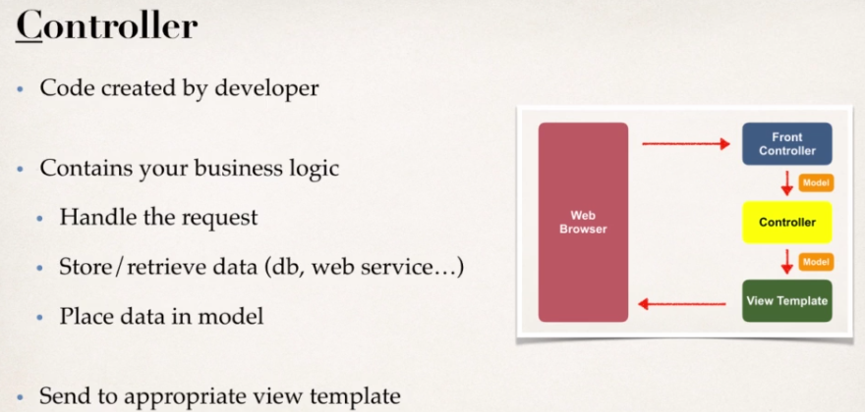
Spring Web MVC – Behind the scene

Slide 9
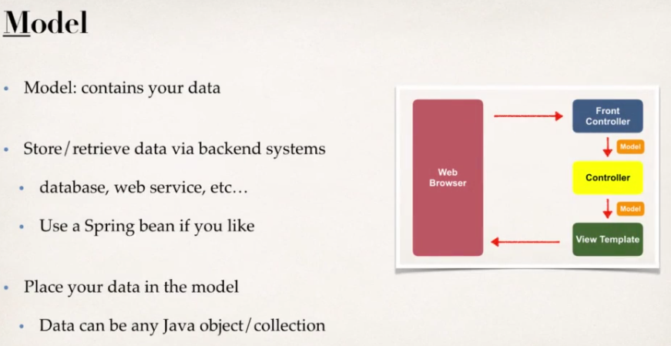
Spring Web MVC – Behind the scene

Slide 10
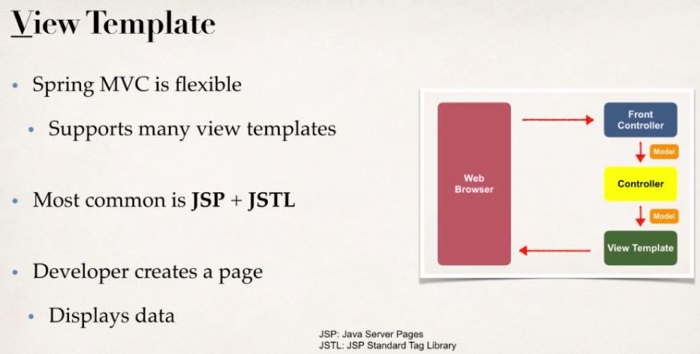
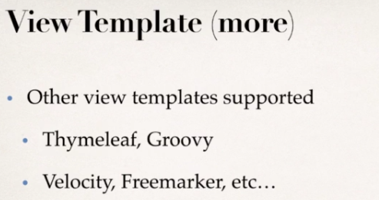
Spring Web MVC – Behind the scene

Slide 11
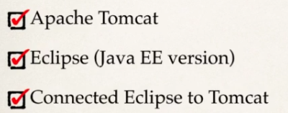
Spring MVC - Configuration
Notes:
https://docs.spring.io/spring-framework/docs/current/reference/html/web.html#mvc-servlet

Slide 12
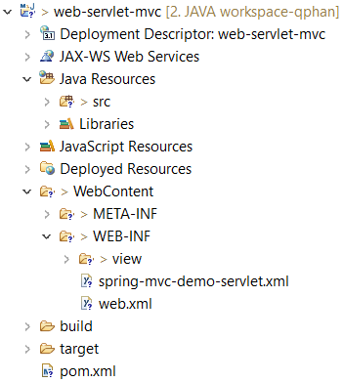
Spring MVC – Configuration

Slide 13
Spring MVC
Home Controller - View
Notes:
https://docs.spring.io/spring-framework/docs/current/reference/html/web.html#mvc-servlet

Slide 14
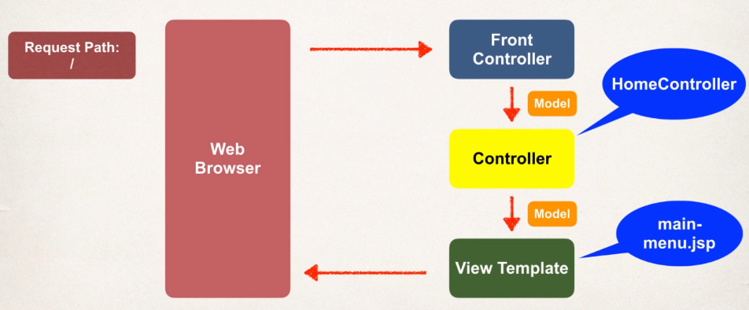
Spring MVC – Controller View

Slide 15
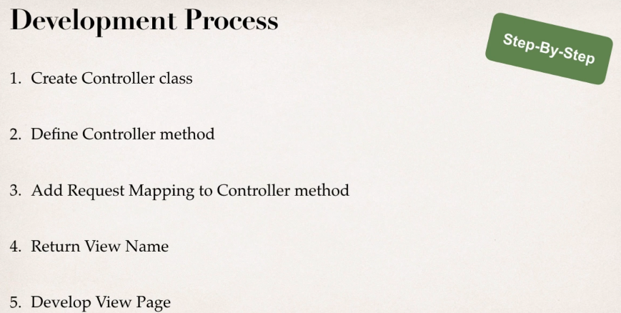
Spring MVC – Controller View
Receive/handle request from web browser

Slide 16
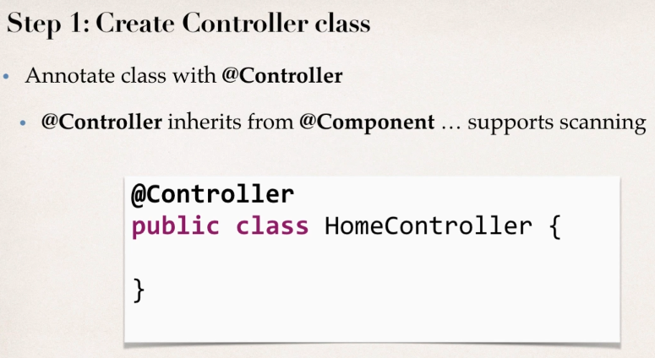
Spring MVC – Controller View

Slide 17
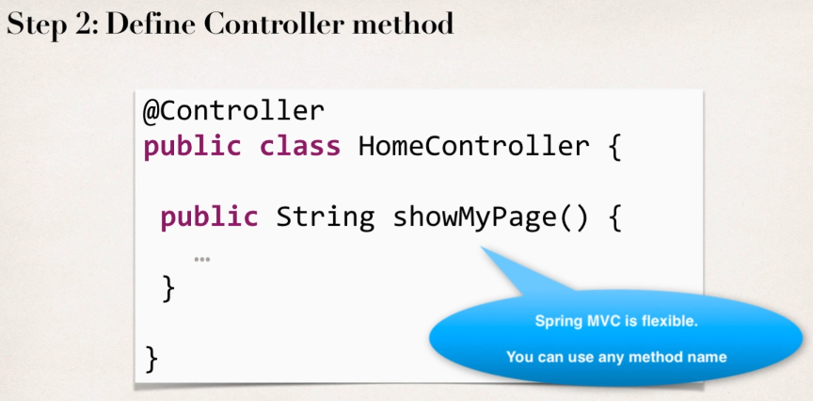
Spring MVC – Controller View

Slide 18
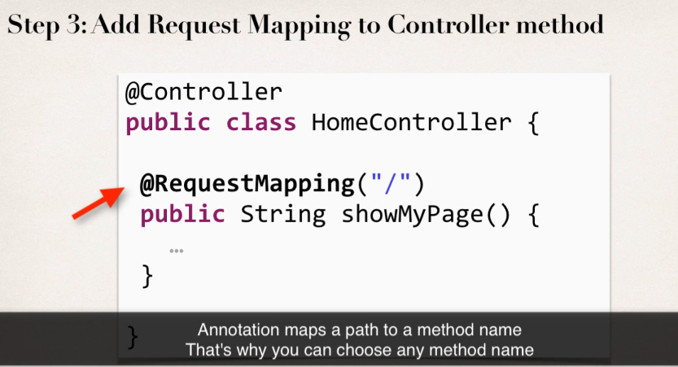
Spring MVC – Controller View

Slide 19
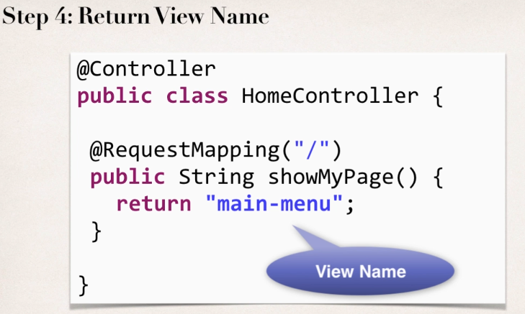
Spring MVC – Controller View

Slide 20
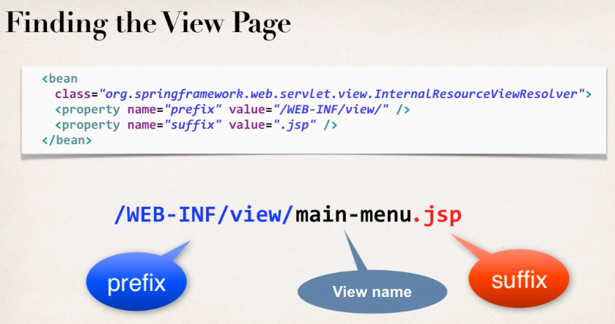
Spring MVC – Controller View

Slide 21
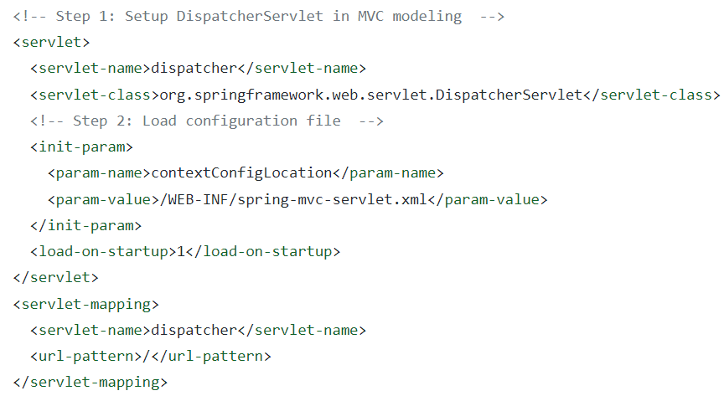
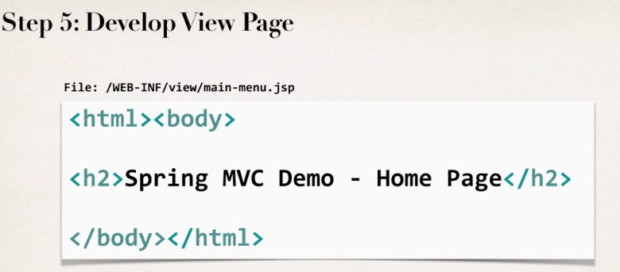
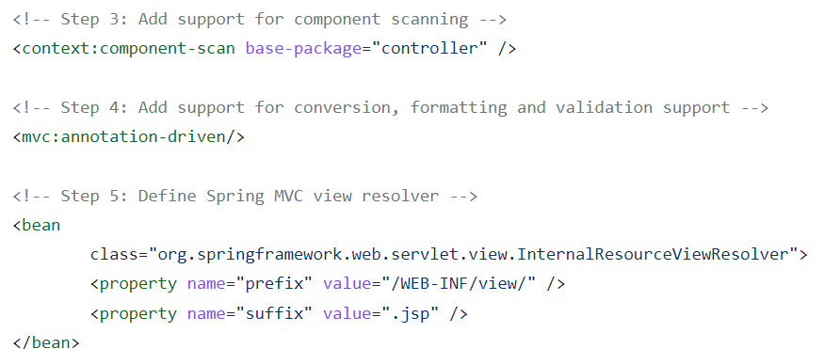
Spring MVC – Controller View
Configuration for a Spring Web MVC project
Dispatcher Servlet – Front Controller
Required Bean Configuration
A. Configure Component Scan Package B. Enable for scanning C. Add View Template
Notes:
https://github.com/j4tdn/springio/blob/development/web-servlet-mvc/WebContent/WEB-INF/web.xml
https://gist.github.com/darbyluv2code/ce14cc50ac154e8bebba231a9cfc3f81
---
https://stackoverflow.com/questions/8162459/what-does-mvcannotation-driven-do
The mvc:annotationDriven tag essentially sets you your Spring context to allow for dispatching requests to Controllers.
The tag will configure two beans DefaultAnnotationHandlerMapping and AnnotationMethodHandlerAdapter.

Slide 22
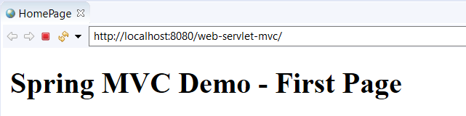
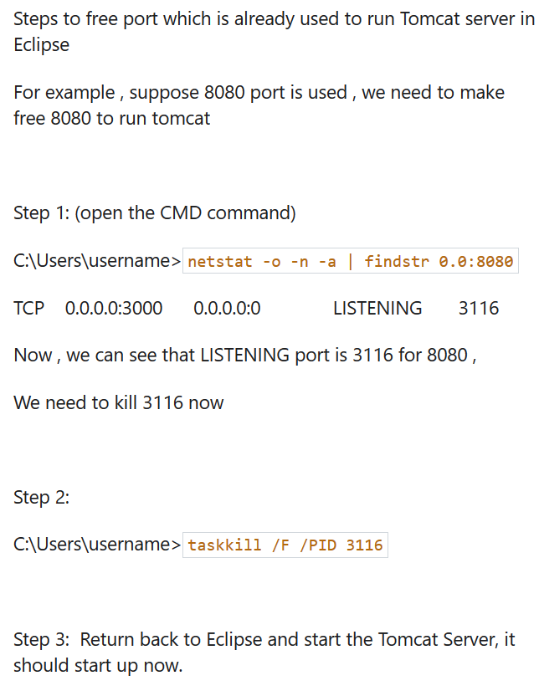
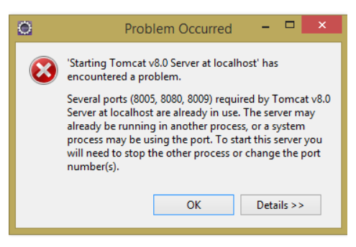
Spring MVC – Controller View

Slide 23
Spring MVC
Processing - Form - Data
Notes:
https://docs.spring.io/spring-framework/docs/current/reference/html/web.html#mvc-servlet

Slide 24
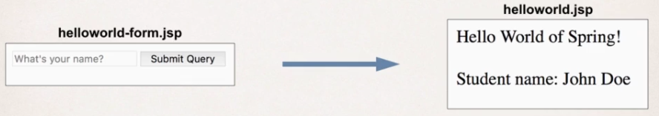
Spring MVC – Controller View
Notes:
form -- submit -- greet

Slide 25
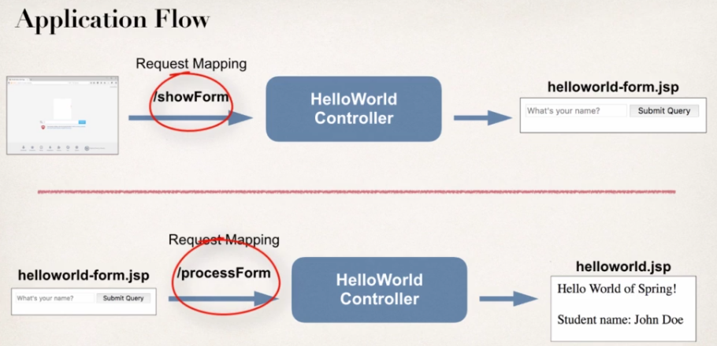
Spring MVC – Controller View

Slide 26
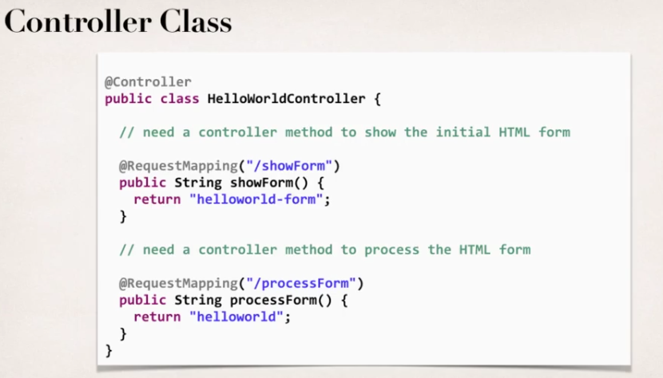
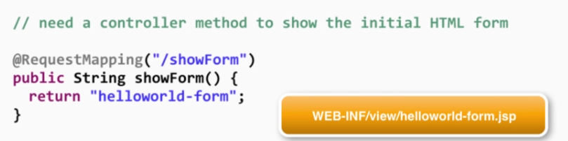
Spring MVC – Controller View

Slide 27
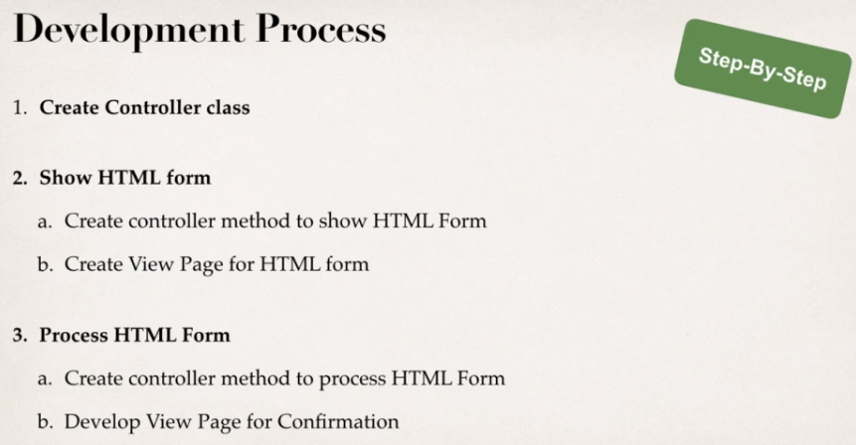
Spring MVC – Controller View
Notes:
Student Page

Slide 28
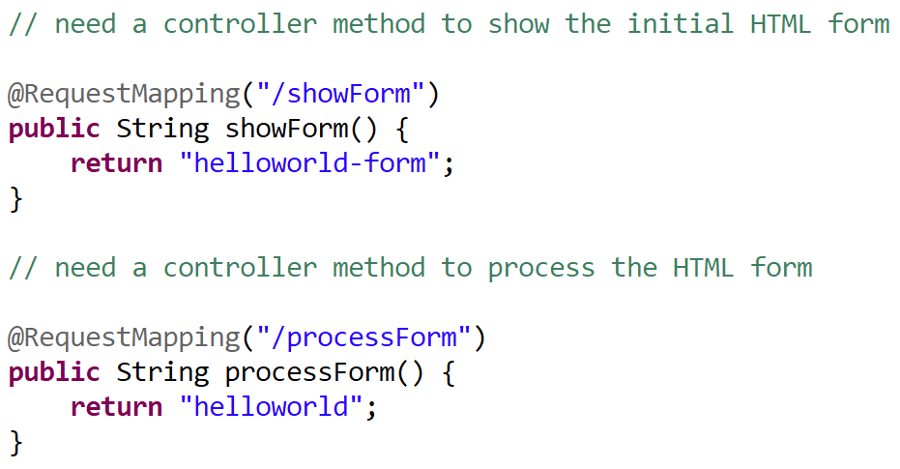
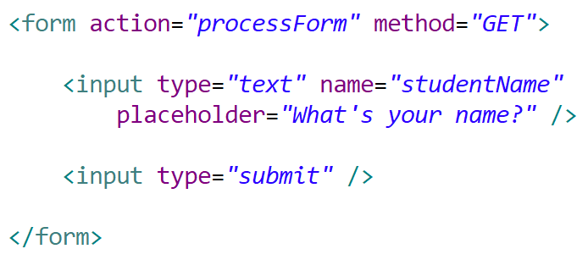
Spring MVC – Controller View
prefix/../helloworld-form.jsp
Notes:
coding

Slide 29
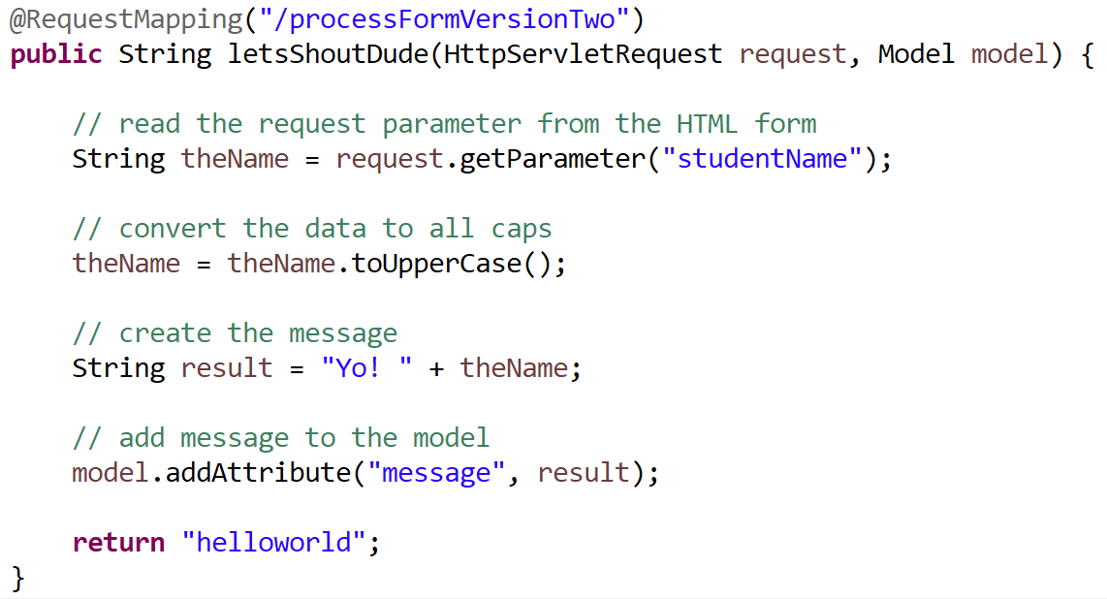
Spring MVC – Controller View
Adding data to Spring Model
Notes:
coding

Slide 30
Spring MVC
Request Mapping – Request Param
Notes:
https://docs.spring.io/spring-framework/docs/current/reference/html/web.html#mvc-servlet

Slide 31
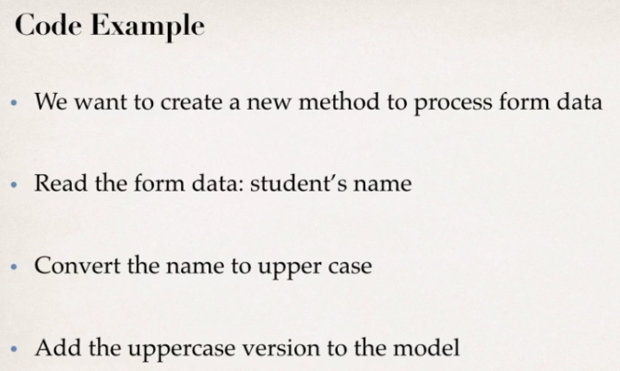
Spring MVC – Request Param - Mapping
Notes:
coding

Slide 32
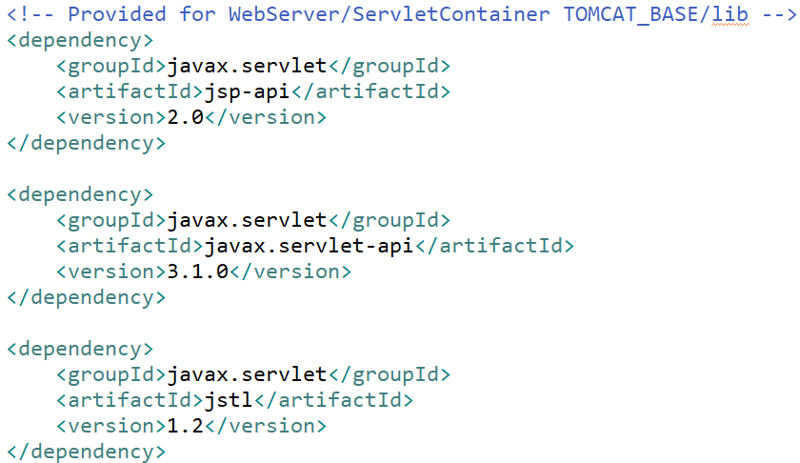
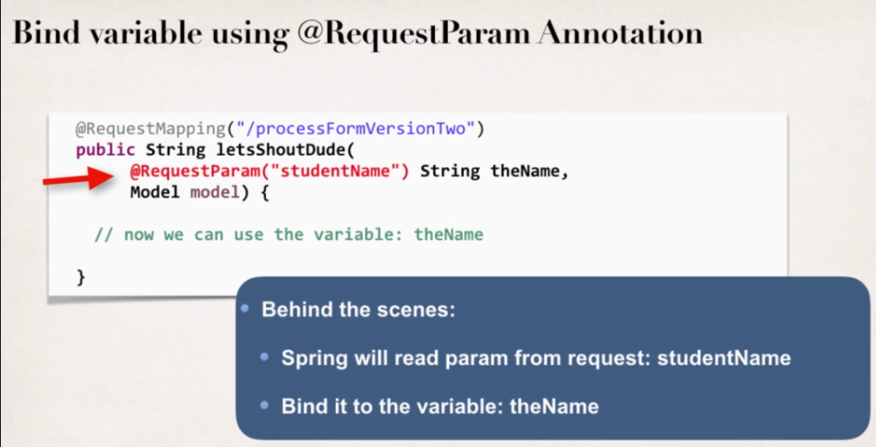
Spring MVC – Request Param - Mapping
Notes:
coding

Slide 33
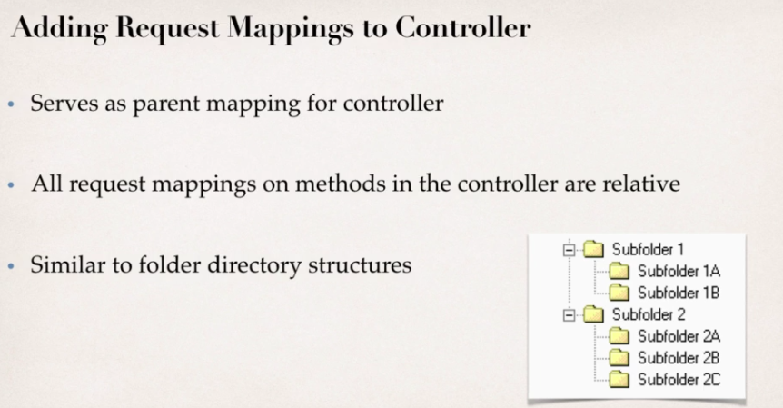
Spring MVC – Request Param - Mapping
Notes:
coding

Slide 34
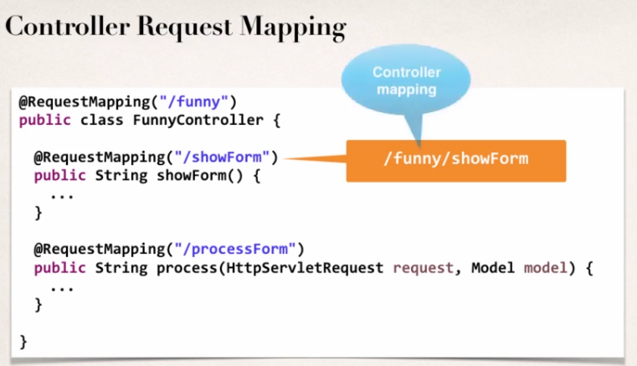
Spring MVC – Request Param - Mapping
GetMapping - PostMapping

Slide 35
Spring MVC
Form Tags – Data Binding
Notes:
https://docs.spring.io/spring-framework/docs/current/reference/html/web.html#mvc-servlet

Slide 36
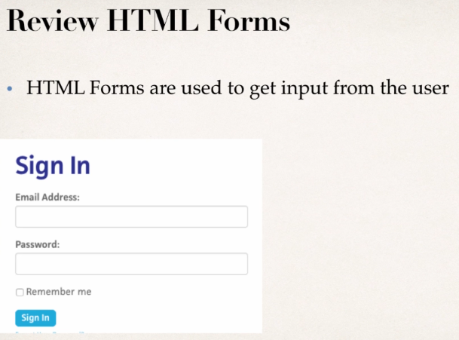
Spring MVC – Form Tags – Data Binding
Notes:
coding

Slide 37
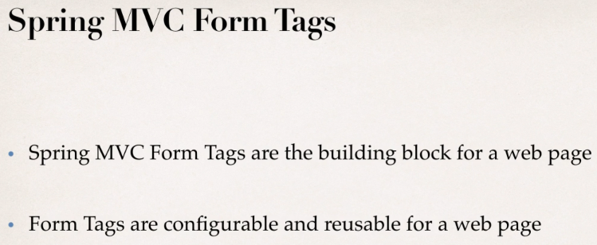
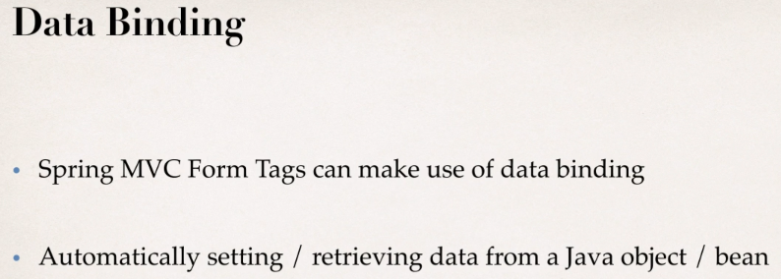
Spring MVC – Form Tags – Data Binding
Notes:
coding

Slide 38
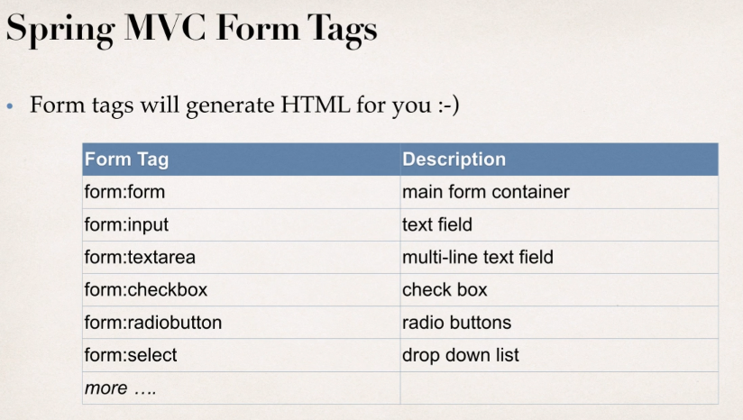
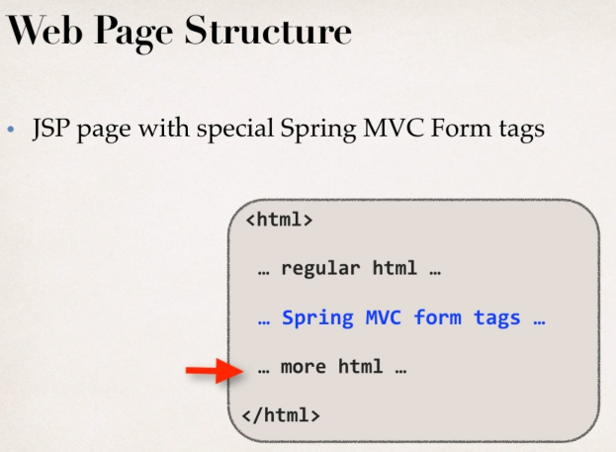
Spring MVC – Form Tags – Data Binding

Slide 39
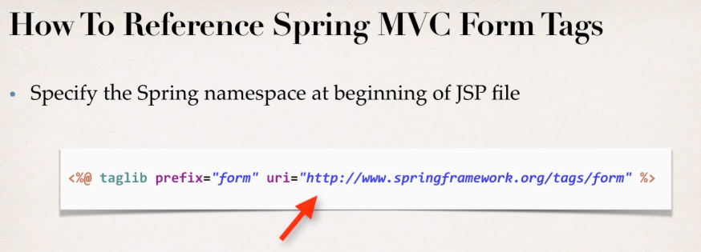
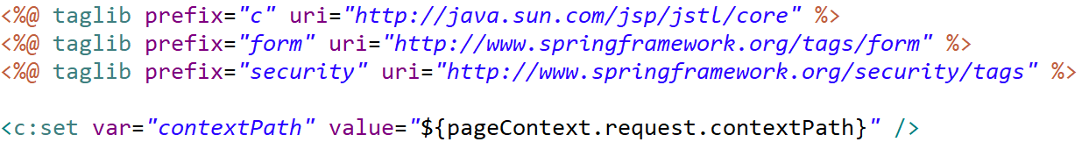
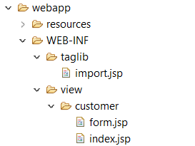
Spring MVC – Form Tags – Data Binding
import.jsp
form.jsp
Notes:
<%@ taglib uri="http://java.sun.com/jsp/jstl/core" prefix="c" %>
<%@ taglib prefix="form" uri="http://www.springframework.org/tags/form" %>

Slide 40
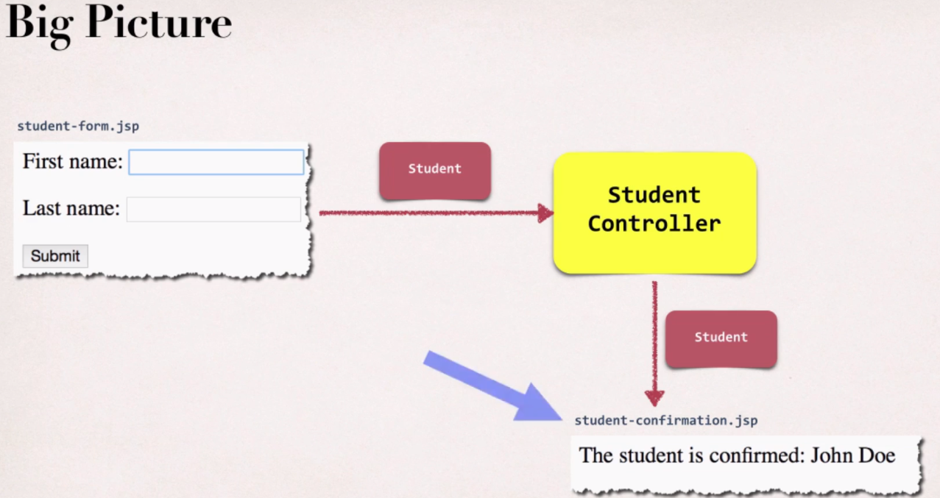
Spring MVC – Form Tags – Data Binding

Slide 41
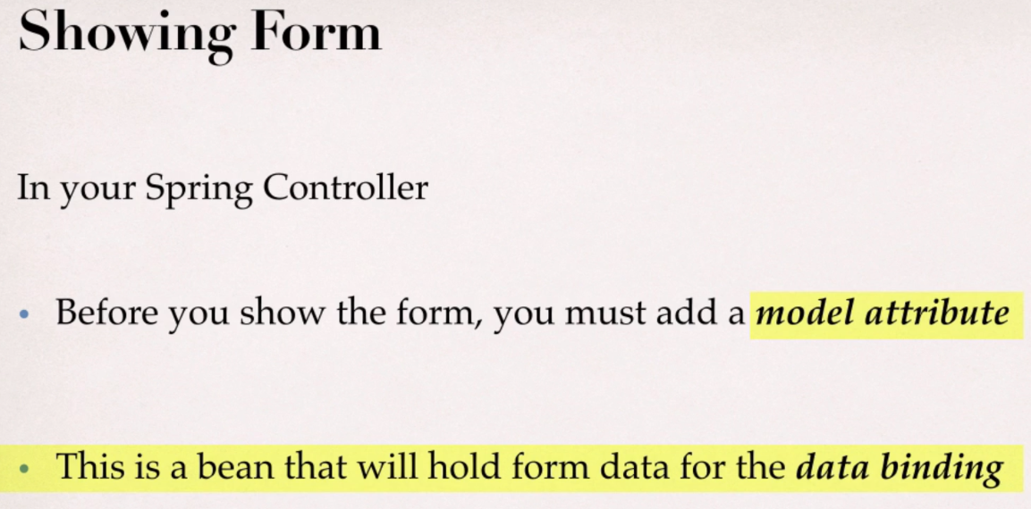
Spring MVC – Form Tags – Data Binding

Slide 42
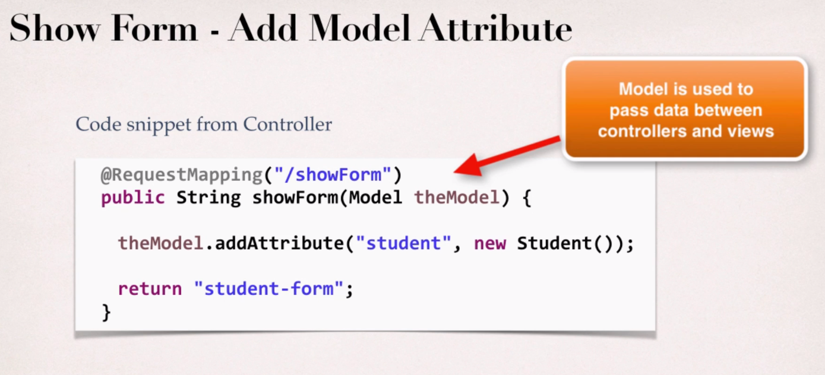

Spring MVC – Form Tags – Data Binding
Notes:
Bean with property student and value new Student

Slide 43
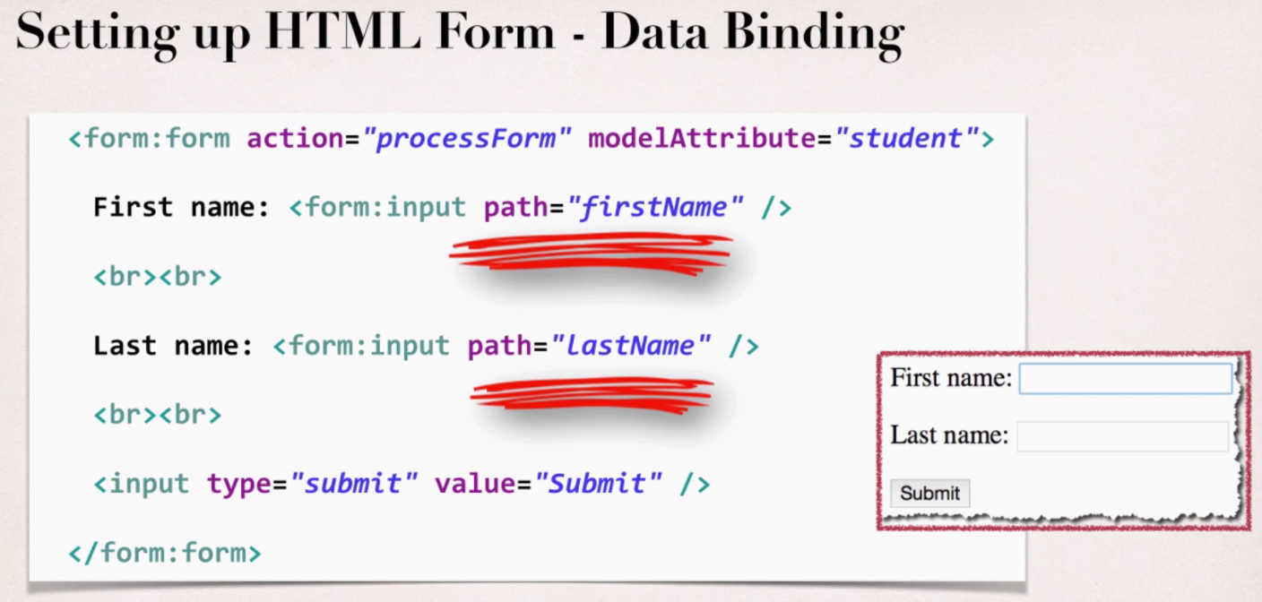
Spring MVC – Form Tags – Data Binding
Notes:
student-form.jsp
<%@ taglib prefix="form" uri="http://www.springframework.org/tags/form" %>

Slide 44

Spring MVC – Form Tags – Data Binding
Notes:
student-form.jsp
<%@ taglib prefix="form" uri="http://www.springframework.org/tags/form" %>

Slide 45

Spring MVC – Form Tags – Data Binding
Notes:
student-form.jsp
<%@ taglib prefix="form" uri="http://www.springframework.org/tags/form" %>

Slide 46

Spring MVC – Form Tags – Data Binding
Notes:
Don’t need to do request.getParameter all the times
Data binding to student-confirmation page automatically

Slide 47

Spring MVC – Form Tags – Data Binding

Slide 48

Spring MVC – Form Tags – Data Binding
Notes:
Demo Student first-name, last-name first

Slide 49

Spring MVC – Form Tags

Slide 50

Spring MVC – Form Tags

Slide 51


Spring MVC – Form Tags

Slide 52

localhost:8080/web-servlet-mvc/resources/css/style.css
Loading static resource
spring-configuration.xml
Java Server Page
Notes:
Loading static file as css, js, images

Slide 53
Spring MVC - Form Validation
Applying Built-in Validation Rules
Notes:
https://docs.spring.io/spring-framework/docs/current/reference/html/web.html#mvc-servlet

Slide 54


Spring MVC – Form Validation

Slide 55


Spring MVC – Form Validation

Slide 56

Spring MVC – Form Validation

Slide 57

Spring MVC – Form Validation

Slide 58

Spring MVC – Form Validation
Notes:
https://hibernate.org/validator/releases/7.0/

Slide 59


Spring MVC – Form Validation

Slide 60

Spring MVC – Form Validation

Slide 61

Spring MVC – Form Validation

Slide 62

Spring MVC – Form Validation

Slide 63

Spring MVC – Form Validation

Slide 64

Spring MVC – Form Validation

Slide 65

Spring MVC – Form Validation
Notes:
the BindingResult parameter must appear immediately after the model attribute

Slide 66

Spring MVC – Form Validation

Slide 67

Spring MVC – Form Validation

Slide 68

Spring MVC – Form Validation

Slide 69

Spring MVC – Form Validation

Slide 70

Spring MVC – Form Validation

Slide 71

Spring MVC – Form Validation

Slide 72
Spring MVC - Form Validation
Validate Number Ranges and Regular Expression
Notes:
https://docs.spring.io/spring-framework/docs/current/reference/html/web.html#mvc-servlet

Slide 73

Spring MVC – Form Validation

Slide 74

Spring MVC – Form Validation

Slide 75

Spring MVC – Form Validation

Slide 76

Spring MVC – Form Validation

Slide 77

Spring MVC – Form Validation – Custom message

Slide 78

Spring MVC – Form Validation – Custom message

Slide 79


Spring MVC – Form Validation

Slide 80
Spring MVC - Form
Custom Validation
Notes:
https://docs.spring.io/spring-framework/docs/current/reference/html/web.html#mvc-servlet

Slide 81

Spring MVC – Form Validation
Custom Validation

Slide 82

Spring MVC – Form Validation
@StartsWith

Slide 83

Spring MVC – Form Validation

Slide 84

Spring MVC – Form Validation

Slide 85
Spring MVC Configuration
Java Annotation
Notes:
https://docs.spring.io/spring-framework/docs/current/reference/html/web.html#mvc-servlet

Slide 86

Spring MVC – App – Java Config
Dynamic Web Project
Maven Web App Archetype
Notes:
DispatcherServlet || FrontController

Slide 87

Spring MVC – App – Java Config

Slide 88

Spring MVC – App – Java Config

Slide 89

Spring MVC – App – Java Config

Slide 90

Spring MVC – App – Java Config

Slide 91


Spring MVC – App – Java Config

Slide 92

Spring MVC – App – Java Config

Slide 93


Spring MVC – App – Java Config
Notes:
servlet.xml

Slide 94

Spring MVC – App – Java Config

Slide 95


Spring MVC – App – Java Config

Slide 96

Spring MVC – App – Java Config

Slide 97

Spring MVC – App – Java Config

Slide 98

Spring MVC – App – Java Config
Notes:
theCode: textfield data

Slide 99
Spring MVC and Hibernate
Notes:
https://docs.spring.io/spring-framework/docs/current/reference/html/web.html#mvc-servlet

Slide 100

Spring MVC – Hibernate

Slide 101

Spring MVC – Hibernate

Slide 102


Spring MVC – Hibernate

Slide 103
Spring MVC – Hibernate
Notes:
Tự làm ở nhà

Slide 104

Spring MVC – Hibernate
Searching
Sorting
CRUD
VIEW
Pagination

Slide 105

Spring MVC – Hibernate
Notes:
Tự làm ở nhà

Slide 106

Spring MVC – Hibernate
Notes:
Tự làm ở nhà

Slide 107

Spring MVC – Hibernate
Notes:
theCode: textfield data

Slide 108

Spring MVC – Hibernate

Slide 109

Spring MVC – Hibernate
Notes:
theCode: textfield data

Slide 110

Spring MVC – Hibernate
Notes:
theCode: textfield data

Slide 111

Spring MVC – Hibernate
Notes:
theCode: textfield data

Slide 112

Spring MVC – Hibernate
Notes:
theCode: textfield data

Slide 113

Spring MVC – Hibernate
Notes:
theCode: textfield data

Slide 114

Spring MVC – Hibernate
Notes:
theCode: textfield data

Slide 115


Spring MVC – Hibernate
Notes:
theCode: textfield data

Slide 116

Spring MVC – Hibernate
Notes:
theCode: textfield data

Slide 117

Spring MVC – Hibernate
Notes:
theCode: textfield data

Slide 118

Spring MVC – Hibernate
Notes:
theCode: textfield data

Slide 119

Spring MVC – Hibernate

Slide 120
Spring MVC – Hibernate
Searching
Sorting
CRUD
VIEW
Pagination
Notes:
Skip Sorting, Searching, Pagination

Slide 121


END

